Slide 1

19CS2211 - Software Engineering
CMMI and Six Sigma
Session 26

Slide 2

Outline
Agenda:
Definition – CMMI
Levels of CMMI
Six Sigma
Questions

Slide 3
CMMI
Definition
The Capability Maturity Model Integration (CMMI) is a process and behavioral model that helps organizations streamline process improvement and encourage productive, efficient behaviors that decreases risks in software, product and service development.

Slide 4
Levels of CMMI
Each process area (e.g., project planning or requirements management) is formally assessed against specific goals and practices and is rated according to the following capability levels:
Level 0: Incomplete
Processes are viewed as unpredictable and reactive
an unpredictable environment that increases risk and inefficiency.

Slide 5
Level 1: Performed
There’s information on how to establish performance goals and then track those goals to make sure they’re achieved at all levels of business maturity.
Level 2: Managed
Projects - planned, performed, measured and controlled – at this level.
But there are still a lot of issues to address.
Level 3: Defined
organizations are more proactive than reactive
A set of “organization-wide standards” to “provide guidance across projects, programs and portfolios.”

Slide 6
Level 4: Quantitatively managed
measured and controlled
quantitative data to determine predictable processes that align with stakeholder needs
Level 5: Optimized
organization’s processes are stable and flexible
organization will be in constant state of improving and responding to changes or other opportunities
Organization is stable, which allows for more “agility and innovation,” in a predictable environment

Slide 7
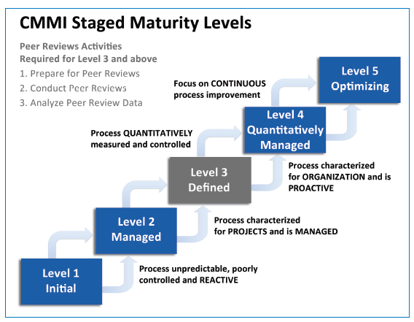

Slide 8
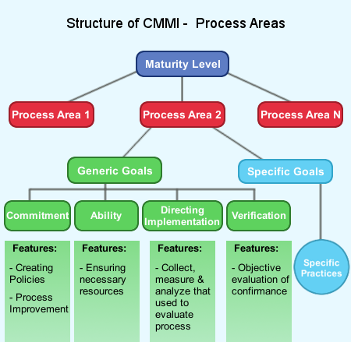

Slide 9
CMMI defines each process area in terms of specific goals
Specific practices required to achieve these goals
Specific practices refine a goal into a set of process-related activities

Slide 10
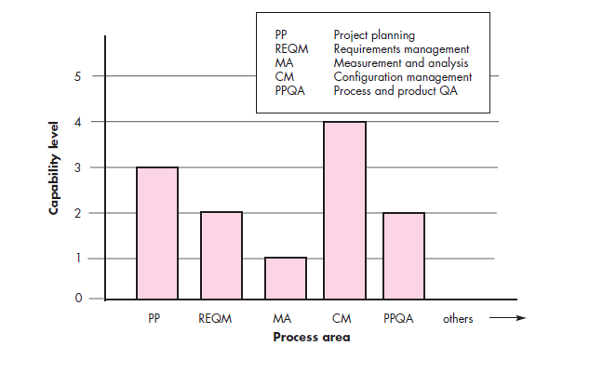
CMMI Process Area Capability Profile

Slide 11
Specific Goals of CMMI
Associated specific practices (SP) defined for project planning are:
SG 1 Establish Estimates
SP 1.1-1 Estimate the Scope of the Project
SP 1.2-1 Establish Estimates of Work Product and Task Attributes
SP 1.3-1 Define Project Life Cycle
SP 1.4-1 Determine Estimates of Effort and Cost
SG 2 Develop a Project Plan
SP 2.1-1 Establish the Budget and Schedule
SP 2.2-1 Identify Project Risks
SP 2.3-1 Plan for Data Management
SP 2.4-1 Plan for Project Resources
SP 2.5-1 Plan for Needed Knowledge and Skills
SP 2.6-1 Plan Stakeholder Involvement
SP 2.7-1 Establish the Project Plan
SG 3 Obtain Commitment to the Plan
SP 3.1-1 Review Plans That Affect the Project
SP 3.2-1 Reconcile Work and Resource Levels
SP 3.3-1 Obtain Plan Commitment

Slide 12
CMMI also defines a set of five generic goals
The generic goals (GG) and practices (GP) for the project planning process area are:
GG 1 Achieve Specific Goals
GP 1.1 Perform Base Practices
GG 2 Institutionalize a Managed Process
GP 2.1 Establish an Organizational Policy
GP 2.2 Plan the Process
GP 2.3 Provide Resources
GP 2.4 Assign Responsibility
GP 2.5 Train People
GP 2.6 Manage Configurations
GP 2.7 Identify and Involve Relevant Stakeholders
GP 2.8 Monitor and Control the Process
GP 2.9 Objectively Evaluate Adherence
GP 2.10 Review Status with Higher-Level Management

Slide 13
GG 3 Institutionalize a Defined Process
GP 3.1 Establish a Defined Process
GP 3.2 Collect Improvement Information
GG 4 Institutionalize a Quantitatively Managed Process
GP 4.1 Establish Quantitative Objectives for the Process
GP 4.2 Stabilize Subprocess Performance
GG 5 Institutionalize an Optimizing Process
GP 5.1 Ensure Continuous Process Improvement
GP 5.2 Correct Root Causes of Problems

Slide 14
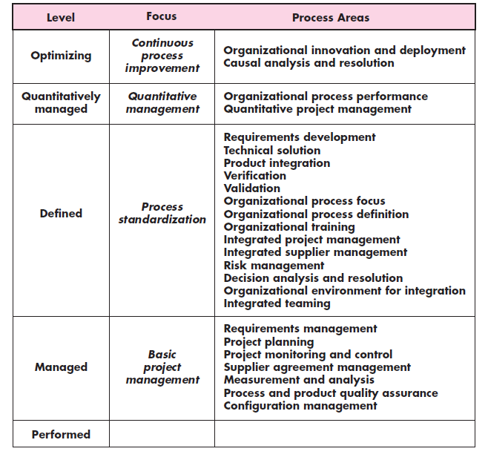
Process area required to achieve a maturity Level

Slide 15
Six Sigma for Software Engineering
Six Sigma – suitable for statistical quality assurance in industry today
It uses data and statistical analysis to measure and improve a company’s operational performance by identifying and eliminating defects’ in manufacturing and service-related processes
The term Six Sigma is derived from six standard deviations—3.4 instances (defects) per million occurrences—implying an extremely high quality standard

Slide 16
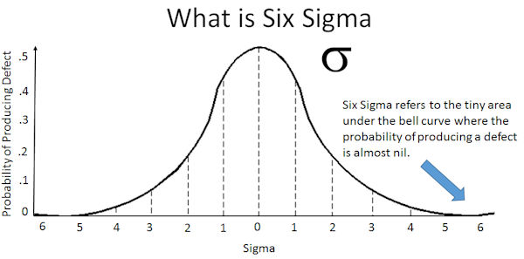

Slide 17
The Six Sigma methodology defines three core steps:
Define
customer requirements
deliverables and
project goals
via well defined methods of customer communication
Measure the existing process and its output to determine current quality performance (collect defect metrics).
Analyze defect metrics and determine the vital few causes.

Slide 18
If an existing software process is in place, but improvement is required, Six Sigma suggests two additional steps:
Improve the process by eliminating the root causes of defects
Control the process to ensure that future work does not reintroduce the causes of defects
These core and additional steps are sometimes referred to as the DMAIC (define, measure, analyze, improve, and control) method

Slide 19
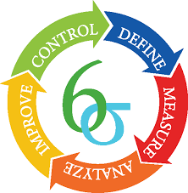

Slide 20
If an organization is developing a software process (rather than improving an existing process), the core steps are augmented as follows:
Design the process
to avoid the root causes of defects
to meet customer requirements
Verify that the process model to avoid defects and meet customer requirements.
This variation is sometimes called the DMADV (define, measure, analyze, design, and verify) method.

Slide 21
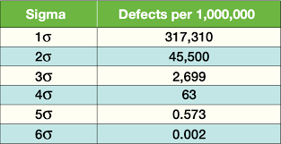

Slide 22
Questions
Distinguish CMMI and Six Sigma Method.
Explain various levels of CMMI in detail.
Explain the core and additional steps of Six sigma methodology.
List out specific goals and associated specific practices defined in CMMI.
List out generic goals and practices of CMMI.

Slide 23
Thank You

